Slide 1
Welcome to
Social Media
Quiz

Slide 2
What is
Social Media

Slide 3
Websites and applications that enable users to create and share content or to participate in social networking.

Slide 4
What is this sign and what age do you have to be to use the site?
A. Strike
B. Snapchat
C. 13+
D. 16 +

Slide 5
The Correct Answer is …
B. Snapchat
C. 13+

Slide 6
What age do you have to be to have a Facebook Account?
13+
A.
B. 16+
18+
21+
C.
D.

Slide 7
The Correct Answer is …
A. 13+

Slide 8
How many days a year are spent online by 12% of 8 -13 Year Olds
A. 65
B. 78
C. 55
D. 61

Slide 9
The Correct Answer is …
D. 61

Slide 10
Girls spend more time on line than boys?
A. True
B. False
C.
D.

Slide 11
The Correct Answer is …
B. False
3

Slide 12
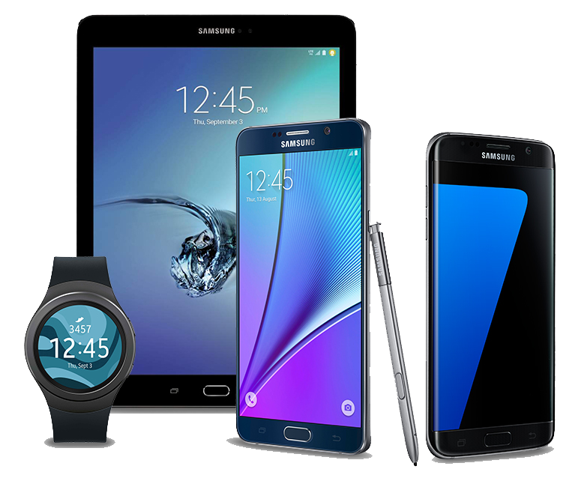
What percentage
of 8-13 year olds
Own their own smart device?
A. 64%
B. 92%
C. 86%
D. 45%

Slide 13
The Correct Answer is …
.
B. 92%

Slide 14
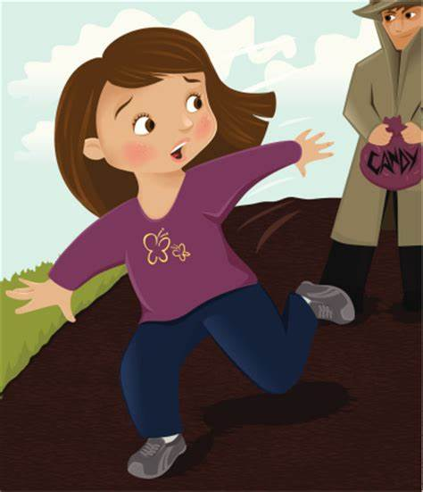
What percentage of children are speaking to strangers online?
A. 43%
B. 37%
C. 64%
D. 19%

Slide 15
The Correct Answer is …
A. 43%

Slide 16
What percentage of children age 8-13 are using snapchat?
A. 38%
B. 44%
C. 19%
D. 33%

Slide 17
The Correct Answer is …
D. 33%

Slide 18
Prioritise the following?
Be Carefull what you post.
Be Carefull who you meet on line
Keep your antivirus up to date
Choose Strong Passwords
Be careful what you download
Make secure purchases
Keep personal information professional.
Keep Privacy Settings on
Practice Safe Browsing
Make sure connection is secure

Slide 19
The Correct Answer is …
Personal Information
Privacy Settings On
Practice Safe Browsing
Safe Internet Connection
Be Careful what you download
Choose Strong Passwords
Make secure online purchases
Be Careful what you post
Be Careful of who you meet
Keep your antivirus up to date.

Slide 20
Thank You &
Well done Everyone

